Slide 1



C# Fundamentals Structs

Slide 2
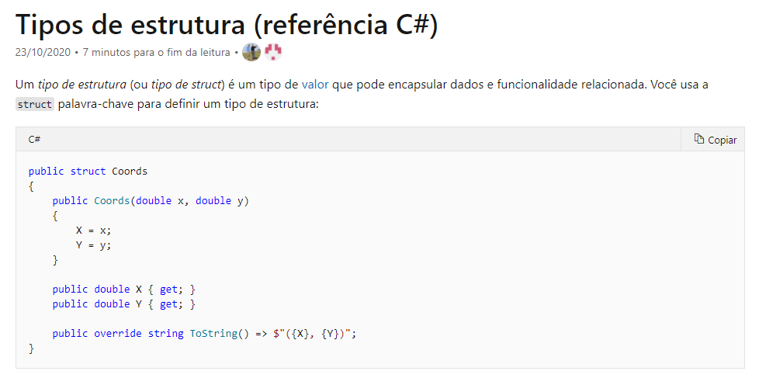
Structs:

Slide 3
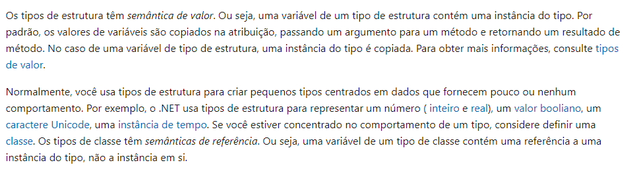
Structs:

Slide 4
Structs:
Links de documentação oficial:
Documentação:
https://docs.microsoft.com/pt-br/dotnet/csharp/language-reference/builtin-types/struct
https://docs.microsoft.com/pt-br/dotnet/csharp/programming-guide/classes-and-structs/classes

Slide 5
Dúvidas?

